Slide 1
Writing Conference, Dissertation, and Thesis Proposals
Matthew Price
Nicolette Hylan
The Graduate Writing Center
gwc.psu@gmail.com

Slide 2
The Graduate Writing Center
One-on-one consultations
All types of writing
All stages of the writing process
To schedule, see the Center’s website:
http://composition.la.psu.edu/resources/graduate-writing-center/GWC
Or go directly to the online schedule:
https://secure.gradsch.psu.edu/wccal/studentview.cfm

Slide 3
Goals of the Workshop
To introduce strategies for bridging the gap between coursework/beginning research and thesis writing.
To help you understand the rhetorical situation of the thesis proposal and common elements of such proposals.
To introduce practical rhetorical and grammatical principles of writing effective proposals.
To provide you with tips for drafting and revising individual sections of the proposal.

Slide 4
The Big Picture
Your proposal describes your proposed plan of work:
What you intend to study (scope and research questions).
How you intend to study your topic (methodology).
Why this topic needs to be studied (significance).
When you will complete this work (timeline).
(Occasionally) Where you will conduct this work.

Slide 5
What is a Proposal?
Purpose
Justify and plan (or contract for) a research project.
Show how your project contributes to existing research.
Demonstrate that you understand how to conduct discipline-specific research in an acceptable time-frame.
Audience
your academic advisor and committee

Slide 6
General Tips
Understand that the proposal will be negotiated--be prepared to revise!
Think of the proposal as an introduction to your thesis or dissertation.
Remember that the proposal is not a binding contract.
Remember that your proposal is meant to help you think practically.
Ask colleagues to form a writing group.
Talk to your advisor (and colleagues)!

Slide 7
Avoiding Anxiety
Establish a writing schedule.
Begin by free-writing.
Keep a small notebook with you to write down relevant thoughts.
Say parts of your writing into a recording device.
Compose different parts in different computer files or on different index cards.
Start with more “clear cut” sections first.

Slide 8
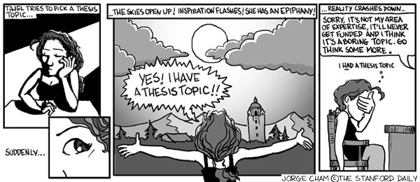
Developing a Focused Project

Slide 9
Developing a Focused Project
Read widely in your subject area. Keep a list of questions that haven’t yet been asked or answered.
Draw from the reading you’ve done for coursework and other research projects.
Don’t try to read everything—more is always being published, so just get a sense of what’s going on, enough to construct a story or narrative of work on the topic.
Trust your own knowledge—you know more than you think you do.
If you find a thesis, book, or article on “your” topic, don’t panic—read it carefully and look for ways to develop from it or a new perspective to take on the issue.

Slide 10
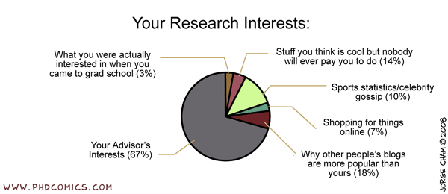
Entering the Academic Conversation

Slide 11
Parts of a Proposal
Title
Abstract
Introduction/
Background
Problem Statement
Purpose and
Research Questions
Review of Literature
Methodology
Significance/ Implications
Overview of Chapters
Plan of Work
Bibliography

Slide 12
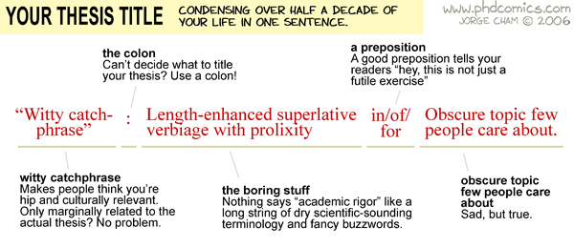
Titles

Slide 13
Creating a Working Title
Orient your readers to your research topic.
Indicate the type of study.
Consider how people will search for your work on the internet and in databases.
Effective Examples:
Role of the Hydrologic Cycle in Vegetation Response to Climate Change: An Analysis Using VEMAP Phase 2 Model Experiments
Geographic Representations of the Planet Mars, 1867-1907
Ineffective Examples:
VEMAP Analysis of Vegetation Response
The Whatness of Books

Slide 14
Abstract
Provide a brief (100-350 word) overview of the proposal
Summarize important elements (Introduction, Statement of the Problem, Background of the Study, Research Questions or Hypotheses, and Methods and Procedures).
An effective abstract interests a reader by answering What? Why? and How?
What am I doing?
Why does it need to be done?
How am I going about it?

Slide 15
Introduction/Background
Establish the general territory (real world or research).
Describe the foundations of your study—provide sufficient background for readers.
Indicate the general scope of your project.
Provide an overview of sections (optional).
Engage the readers.

Slide 16
Organization: Creating a Research Space
Move #1
Establishing a Territory
Show central, problematic, relevant, or interesting aspect of general topic.
Introduce and review previous research.
Sentence-Level Strategies:
Recently, there has been growing interest in . . .
The development of . . . is a classic problem in . . .
The development of . . . has led to the hope that . . .
The study of . . . has become an important aspect of . . .
(The) . . . has been extensively studied in recent years.
Many investigators have recently turned to . . .

Slide 17
Organization: Creating a Research Space
Move #2
Creating a Niche
Indicate a gap in or extend previous knowledge
Sentence-Level Strategies:
Negative:
However, little attention has been dedicated to…
Few studies/investigators/researchers have asked/examined/considered…
Yet none of these studies/findings/calculations have…
Contrastive:
The research has tended to focus on… rather than on…
These studies have emphasized… as opposed to…
Build by raising a question, hypothesis, or need:
However, it remains unclear whether…
If these results could be confirmed, they would provide strong evidence for…
It would thus be of interest to learn how…

Slide 18
Organization: Creating a Research Space
Move #3
Occupying the Niche
Outline purposes
List Research Questions or Hypotheses
Announce principle findings
State value of research
Preview structure of paper
Sentence-Level Strategies:
This project, then, asks…
To further demonstrate this problem and my plan for addressing it, I will first… then… and finally…
The present study, then, aims to contribute to the understanding of … by…

Slide 19
Introduction: Example
Although they did not know of the germs the animals might carry, residents of US cities in the 1860s and 70s cited the flies, roaches, and rats who swarmed the tenements in arguing for community sanitary programs. In the 1950s vermin provided justification for housing and health agencies to pursue urban renewal, and also gave tenant activists a striking symbol of officials’ neglect of their neighborhoods. Today, though we know that vermin produce indoor allergens, and we have pesticides designed to keep vermin at bay, the fact that both may be hazardous confuses parents, health officials, and other advocates who seek to protect health. As long as people have lived in cities, pest animals have joined us in our homes and buildings, affected our health, and propelled our policies on the urban environment. The social geography of pests, however, reflects the social position and physical surroundings of our neighborhoods.
The researcher’s objective is to use the ecological history and social geography of pest animals, which have been blamed for several kinds of disease exposures throughout the past two centuries, to investigate how health and environmental conditions are connected with poverty in cities.

Slide 20
Introduction: Example
Move 1: Establishing a Territory
Although they did not know of the germs the animals might carry, residents of US cities in the 1860s and 70s cited the flies, roaches, and rats who swarmed the tenements in arguing for community sanitary programs. In the 1950s vermin provided justification for housing and health agencies to pursue urban renewal, and also gave tenant activists a striking symbol of officials’ neglect of their neighborhoods. Today, though we know that vermin produce indoor allergens, and we have pesticides designed to keep vermin at bay, the fact that both may be hazardous confuses parents, health officials, and other advocates who seek to protect health. As long as people have lived in cities, pest animals have joined us in our homes and buildings, affected our health, and propelled our policies on the urban environment. The social geography of pests, however, reflects the social position and physical surroundings of our neighborhoods.
The researcher’s objective is to use the ecological history and social geography of pest animals, which have been blamed for several kinds of disease exposures throughout the past two centuries, to investigate how health and environmental conditions are connected with poverty in cities.

Slide 21
Introduction: Example
Move 2:
Creating a Niche
Although they did not know of the germs the animals might carry, residents of US cities in the 1860s and 70s cited the flies, roaches, and rats who swarmed the tenements in arguing for community sanitary programs. In the 1950s vermin provided justification for housing and health agencies to pursue urban renewal, and also gave tenant activists a striking symbol of officials’ neglect of their neighborhoods. Today, though we know that vermin produce indoor allergens, and we have pesticides designed to keep vermin at bay, the fact that both may be hazardous confuses parents, health officials, and other advocates who seek to protect health. As long as people have lived in cities, pest animals have joined us in our homes and buildings, affected our health, and propelled our policies on the urban environment. The social geography of pests, however, reflects the social position and physical surroundings of our neighborhoods.
The researcher’s objective is to use the ecological history and social geography of pest animals, which have been blamed for several kinds of disease exposures throughout the past two centuries, to investigate how health and environmental conditions are connected with poverty in cities.

Slide 22
Introduction: Example
Move 3:
Occupying the Niche
Although they did not know of the germs the animals might carry, residents of US cities in the 1860s and 70s cited the flies, roaches, and rats who swarmed the tenements in arguing for community sanitary programs. In the 1950s vermin provided justification for housing and health agencies to pursue urban renewal, and also gave tenant activists a striking symbol of officials’ neglect of their neighborhoods. Today, though we know that vermin produce indoor allergens, and we have pesticides designed to keep vermin at bay, the fact that both may be hazardous confuses parents, health officials, and other advocates who seek to protect health. As long as people have lived in cities, pest animals have joined us in our homes and buildings, affected our health, and propelled our policies on the urban environment. The social geography of pests, however, reflects the social position and physical surroundings of our neighborhoods.
The researcher’s objective is to use the ecological history and social geography of pest animals, which have been blamed for several kinds of disease exposures throughout the past two centuries, to investigate how health and environmental conditions are connected with poverty in cities.

Slide 23
Purpose and Research Questions
Explain the goals and research objectives.
Show the original contributions.
Provide a more detailed account of the points summarized in the introduction.
Include a rationale for the study.
Be clear about what your study will not address.
In addition, this section may:
Describe the research questions and/or hypotheses.
Include definitions of important terms.
State limitations of the research.
Provide a rationale for the particular subjects of the study.

Slide 24
Purpose: Example 1
My objectives are twofold. First, I intend to examine the effects of historic shifts in climate on the interactions of the carbon and water cycles as simulated by the constituent models of VEMAP Phase 2. . . . Second, I will investigate how alterations to future climate, as simulated through the end of the 21st century, are predicted to impact those same cycles and interactions. The linkages between the carbon and water cycles at the regional scale have only recently been the subjects of research; hence, much work remains to improve our understanding of the feedbacks between coupled processes. . . . Questions I plan to investigate include: How does the water balance of a region, including surface runoff, change as a result of climate alterations . . . ?

Slide 25
Purpose Example
The guiding research question is: Under what conditions do Latinos in Queens, NY, switch their ethnic identification? This involves the following specific objectives:
To document the incidence of multiple ethnic identities among research participants. This involves collecting life histories that focus on the ethnic background of informants and their experience with ethnicity.
To determine the contexts under which people invoke their ethnic identity. This involves collecting data on characteristics of the community and social networks of communities. It will also involve prolonged shadowing observations of the participants (with their consent) in their day-to-day activities. [etc.]

Slide 26
Review of Literature
Writing the literature review allows you to understand:
How other scholars have written about your topic.
The range of theories used to analyze materials or data
How other scholars connect their specific research topics to larger issues, questions, or practices within the field.
The best methodologies and research techniques.

Slide 27
Methodology
Introduce the overall methodological approach.
Indicate how the approach fits the overall research design.
Describe the specific methods of data collection.
Explain how you intend to analyze and interpret your results.
If necessary, provide background and rationale for unfamiliar methodologies.
Address potential limitations.

Slide 28
Tips on Drafting Methodology
Break down your methodology into subsections.
In the physical sciences, these sections may include subjects, design, apparatus, instrumentation, process, analysis, etc.
In the social sciences, these sections may include selection of participants, interview process, profiles, interpretive and analytic framework, methods of qualitative analysis, etc.
In the humanities, these sections may include scholarly research, archival research, theoretical orientation, etc.
Remember that your methods section may also require supporting literature.
Anticipate and pre-empt the audience’s methodological concerns.
Acknowledge major problems.
Justify your approach by showing how benefits outweigh potential problems.

Slide 29
Methodology: Example 1
The research plan will proceed in two phases. During the first phase, I will select a 60-household purposive sample, create and test interview protocols, choose key informants, and train a research assistant. . . . During the second phase, I will conduct in-depth interviews with key informants and four ethnographic interviews with each household in the sample. At the end of the second phase, I will conduct a series of experimental economic games to determine the norms of trust and reciprocity in the community. . . . The research design has several strengths. First, ethnographic study will yield data with high internal validity about how responses to water scarcity evolve over the wet-to-dry cycle (Kirk and Miller 1986). Second . . . (After providing a rationale for the research design, the author goes on to describe in detail the site selection and methods of data collection and analysis).

Slide 30
Methodology Example
My research draws on a three-tiered methodological approach: close textual analysis of primary source material; historical contextualization of both primary documents and broader socio-cultural framework through archival research and secondary histories; and interpretation of primary texts through theoretical frameworks, including spatial theories and gender studies. (Goes on to describe specific theoretical frameworks).

Slide 31
Significance/Implications
Discuss the methodological, substantive, and/or theoretical contribution.
State the practical and/or theoretical importance of the problem and/or objectives of your study.
Explain the usefulness or benefits of the study to both the outside world and the research community.

Slide 32
Significance/Implications: Example
My research on identity and development is innovative because it brings together analysis of national discourses about Indians with a study of the practices and choices of the individual Indians whose identities are at issue. I believe this research can be helpful to the nation, development agencies, and indigenous organizations as Bolivia works out what a multicultural identity will mean for its people. I am particularly committed to sharing the results of my analysis with the Guaraní people with whom I work, in the hopes that my work will not just be an extraction of truths, but will give them information with which they can better control their lives and resources.

Slide 33
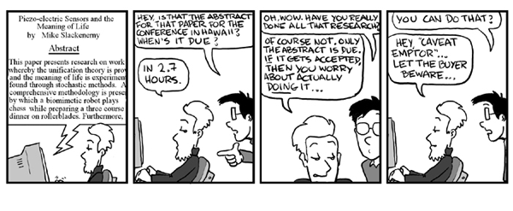
Conference Proposals or Abstracts

Slide 34
Conference Proposals: Three Main Goals
Introduce your topic—identify the need, purpose, and/or audience for your paper and your main research question(s).
Communicate what your paper will look like (explain background information, methods, methodologies, materials of study).
Discuss conclusions and significance. Outline your main arguments or hypotheses. Suggest the broader stakes or applications of the project.

Slide 35
What’s Different?
How is a conference proposal different from a thesis proposal:
Audience
While the audience for your thesis proposal is your advisor, a conference provides a much more general audience with broader interests.
Length
The length of conference proposals is specified by the conference and generally only affords you space to present your major points.
Context
The emphasis in a conference proposal is on developing a cutting-edge idea that is interesting to your field, as opposed to a fully conceived research plan.

Slide 36
Conference Proposals: Dos and Don’ts
Read the submission instructions carefully.
Do not exceed the word or page length.
Identify the argument you will be advancing in the paper. It’s okay to be speculative.
Avoid mention of secondary sources, unless the point of your paper is to engage directly with or revise that work.
Suggest the broader stakes or applications of your project—don’t make it sound too narrow.

Slide 37
Activity
Take a moment to write down the problem or gap that your thesis/dissertation will address (or that you think it will address).
How will your thesis/dissertation solve this problem or gap?

